Slide 1
Manipulating data
Year 11 Biology
Bremer SHS

Slide 2

Welcome to statistics!

Slide 3

Why is this important?
Statistical analysis of data is very important for researchers, as the maths can inform them if there really is a statistically significant difference between the means of the variables or the differences are just due to chance.
For example- say I have 100 men and 100 women and I am testing the hypothesis that men are taller than women. So I randomly pick 5 men and 5 women from the groups and measure their heights. Technically the men I randomly chose could all be short, or the women really tall.
This is why we do multiple trials and then do the statistics. So that statistically speaking, if I do the maths, I will test if there is a statistically significant difference between the groups.

Slide 4
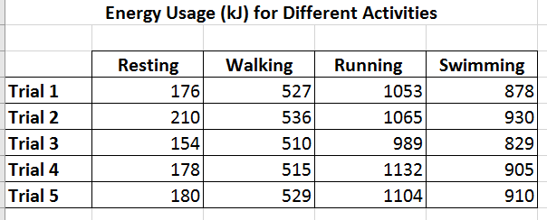
Today’s example
We are going to analyse the following question:
Does physical activity such as walking, running and swimming affect the rate at which the human body uses energy.
The way this was tested:
Record energy usage for each activity after completing it for 30 minutes. Repeat each trial 5 times.
Download your copy of the example now
☺☺☺☺

Slide 5
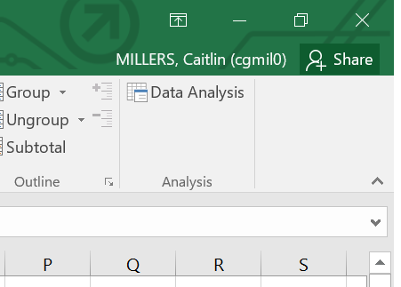
Installing the data analysis toolpak
Install the Data Analysis ToolPak
File Options Add-ins go….
Select Analysis ToolPak ok
Under the Data icon in your taskbar, Data Analysis should now appear at the far end

Slide 6

Measuring the Spread – Descriptive Statistics
In Biology, we will use descriptive statistics to measure the ‘spread’ of data.
Descriptive statistics are used to describe data.
For example, if you were investigating the number of visitors to a beach in August (nice job if you can get it!), you might draw a graph to see how the number of visitors varied each day, work out the average number of visitors each day (using mean, mode or median), work out the range of visitor numbers each day. This would all be descriptive statistics.

Slide 7

the mean/average
The mean is the most commonly used mathematical measure of average and is generally what is being referred to when people use the term average in everyday language. The mean is calculated by totalling all the values in a dataset; this total is then divided by the number of values that make up the dataset.
The formula for the mean is written in the following way:
_ X | is the symbol for the mean and is referred to as bar X (ex)
Σ | is the Greek symbol sigma and simply means sum or add up
X | refers to each of the individual values that make up the dataset
n | is the number of values that make up the dataset

Slide 8
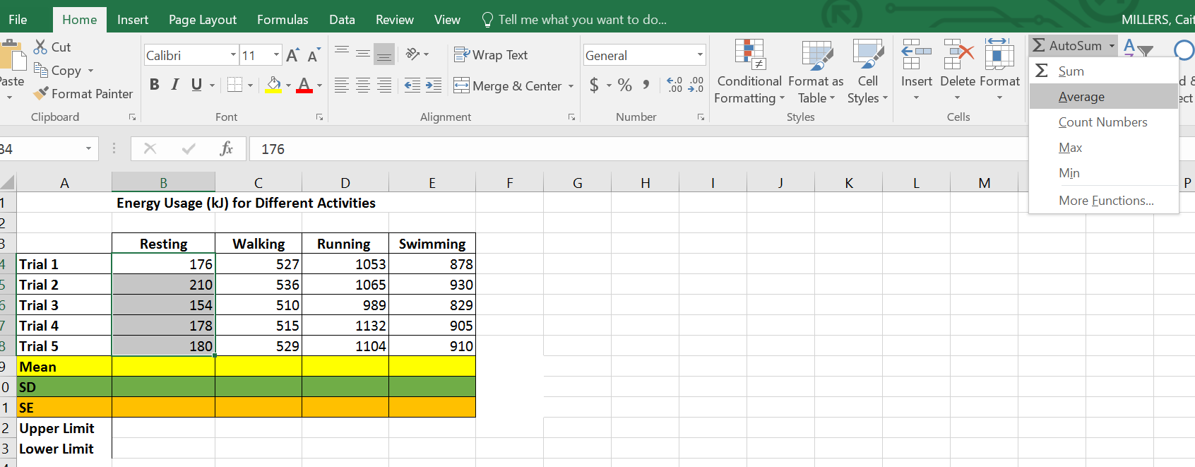
Mean (Example)
The Maths
Mean = 176+210+154+178+180
5
= 179.6
On Excel
Highlight your data
Go to AutoSum
Click the arrow
Click the average
Press enter

Slide 9
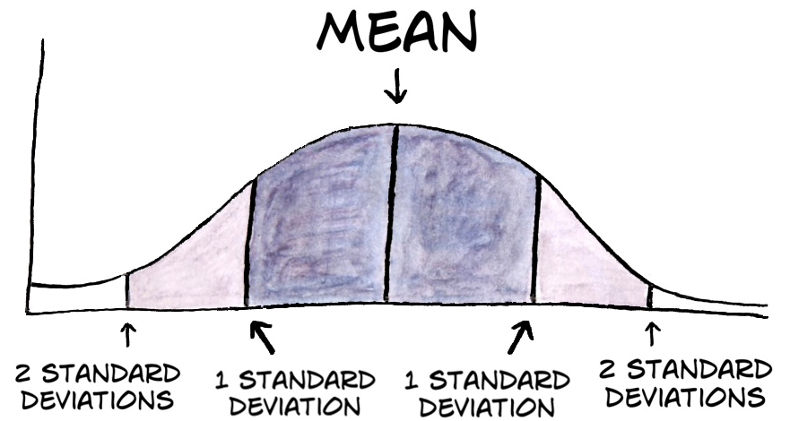
Standard deviation
In statistics, the standard deviation (SD) is a measure that is used to quantify the amount of variation or dispersion of a set of data values.
A low standard deviation indicates that the data points tend to be close to the mean while a high standard deviation indicates that the data points are spread out over a wider range of values.
In science, if any data lies outside 2 SD from the mean than that data is not scientifically accurate and can be removed from the data set. This is called an anomaly or outlier. Once the outlier has been removed, you now use the new data set to complete the calculations.

Slide 10
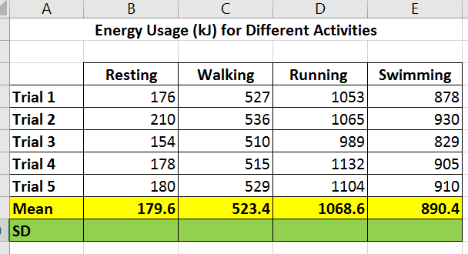
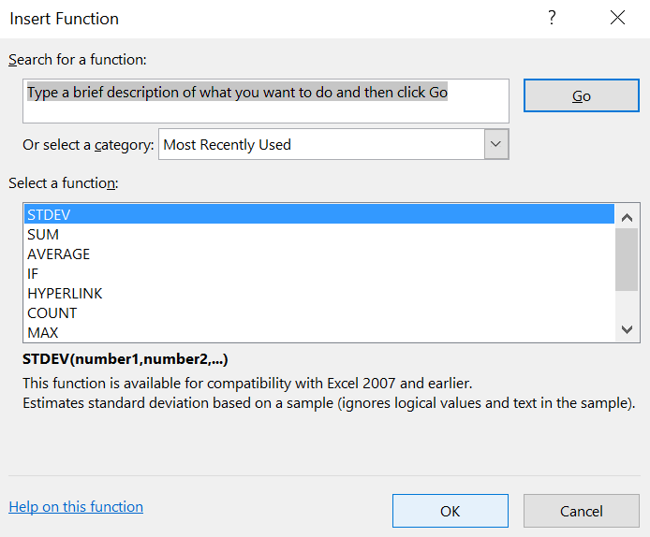
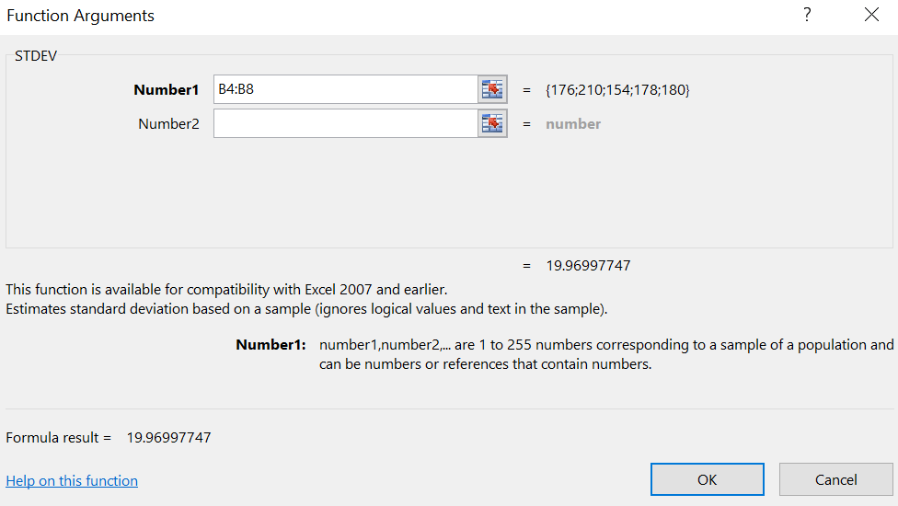
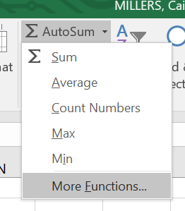
Standard deviation (example)
Step 3: Select STDEV.
Click ok.
Step 4: Click this ‘cell’ button, highlight the data and click it again.
Step 1: Click in the place that you would like your calculation to appear.
Your magic number should be 19.969775!
Step 2: Go to AutoSum
Click More Functions.

Slide 11
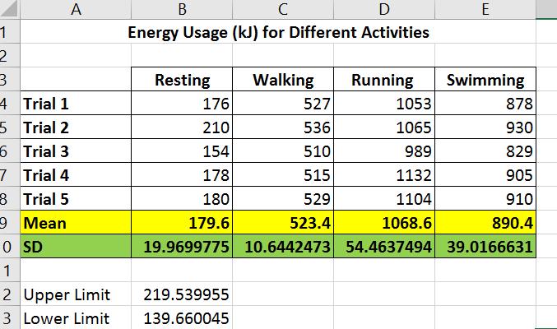
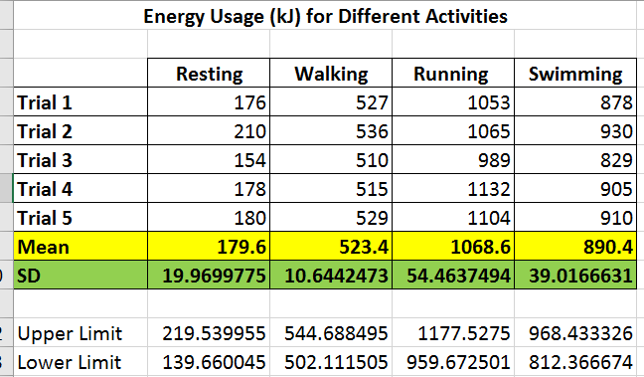
Are there any outliers?
If any data lies outside 2 SD from the mean than that data is not scientifically accurate and can be removed from the data set. This is called an anomaly or outlier. Once the outlier has been removed, you now use the new data set to complete the calculations.
Work out the upper and lower limits of your data set by adding or subtracting the standard deviation twice from the mean.
No Outliers!
Wahoo!

Slide 12
Standard error
When you take a sample and calculate the mean, it is important to remember that this is only an estimate of the true mean for the whole of the population you are measuring.
If you took a second sample, you would probably arrive at a slightly different estimate of the mean.
There is no reason to suppose that the real mean will be exactly equal to the sample mean.
It is likely to be close to it, however, and the amount by which it is likely to differ from the estimate can be found from the standard error.

Slide 13
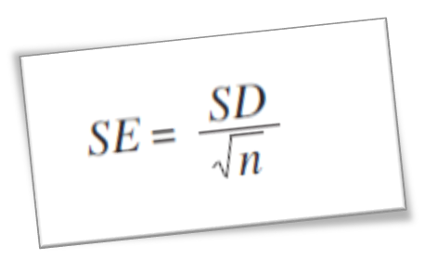
The Standard Error of a mean is calculated using the following formula:
The Standard Error value gives us the range that the mean falls within.
So once the SE is calculated, you calculate the upper SE value by adding the SE to the mean, and calculate the lower SE value by subtracting the SE from the mean.
The range between these 2 numbers is where the true mean will lie. These values can then be graphed along as a bar

Slide 14
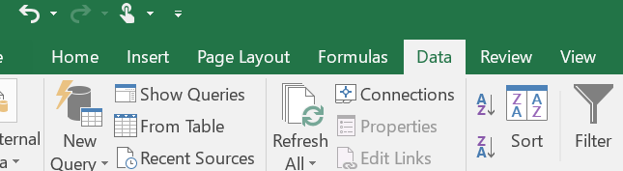
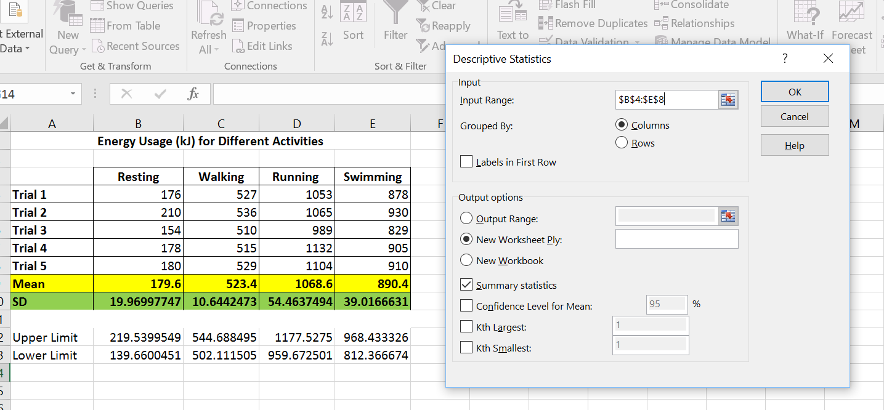
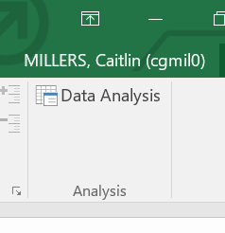
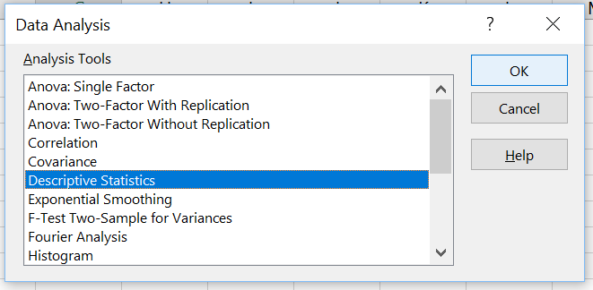
TO CALCULATE MEAN, STANDARD DEVIATION AND STANDARD ERROR…
Step 1: Go to the data tab and click on Data Analysis.
Step 3: Click on the ‘cell’ button and highlight all the data then click the ‘cell’ button again. Tick Summary statistics (by clicking in the box) and then press ok.
Step 2: Click on Descriptive Statistics

Slide 15
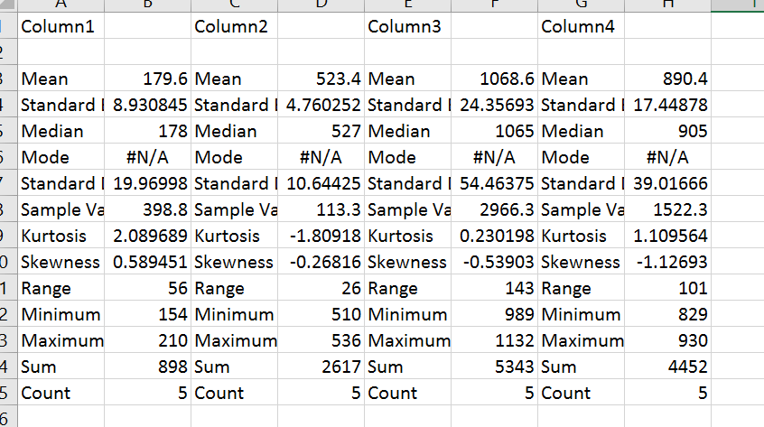

Descriptive summary

Slide 16
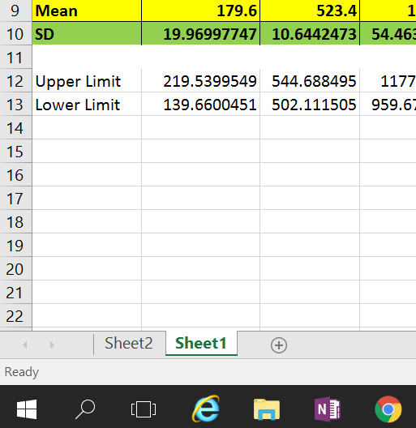
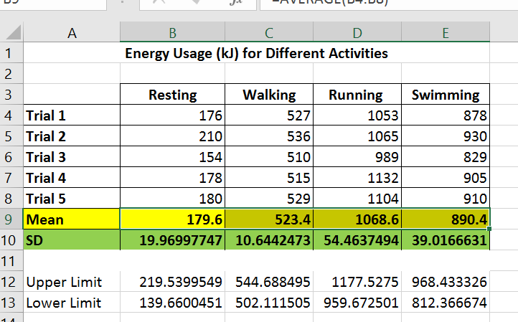
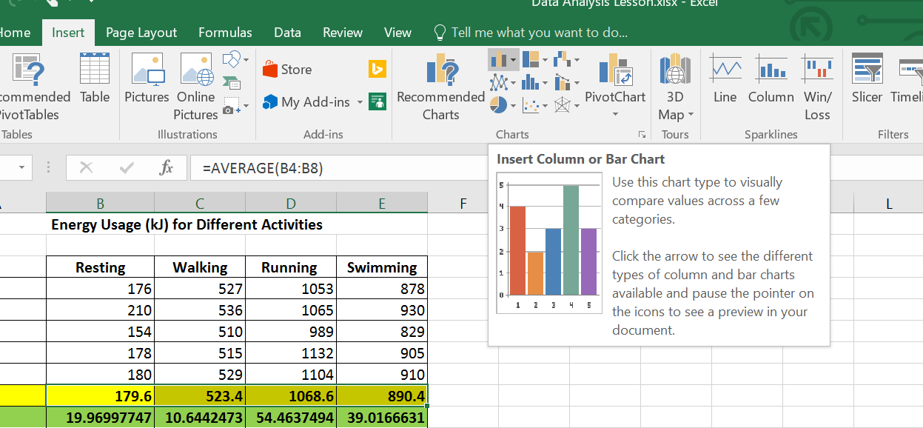
Graphing your data
Once you have your table complete now it is time to graph your data.
Important note- unless you are extrapolating or interpolating the line, when displaying your data in a graph, make it a column graph.
Step 1: Go back to sheet one.
Step 2: Highlight your mean values.
Step 3: Go to insert and select column graph.

Slide 17
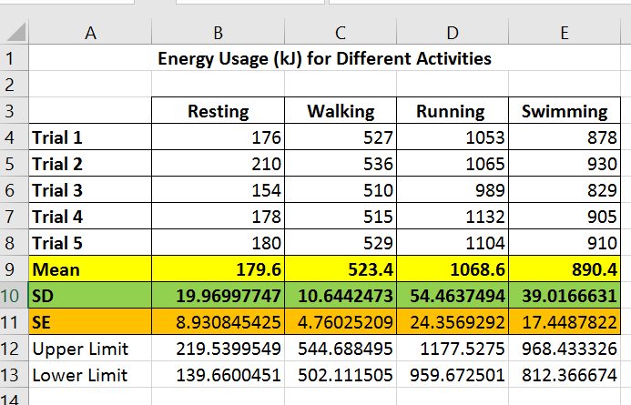
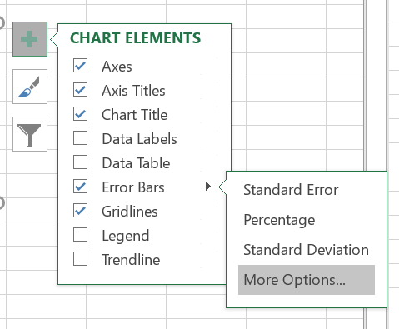
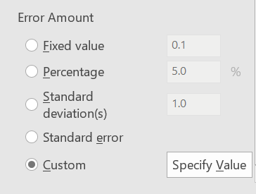
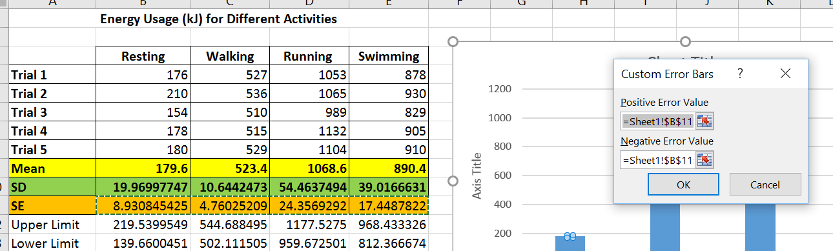
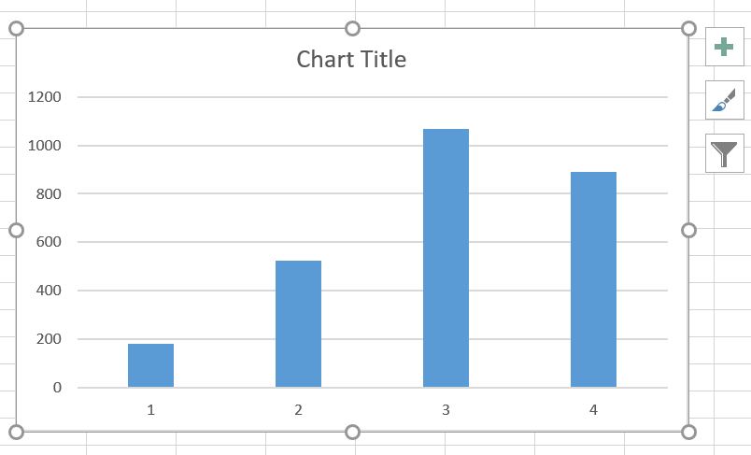
Adding error bars
Step 3: Click on error bars, go to more options.
Step 4: Scroll down and click specify values.
Step 1: Copy the standard error calculations from sheet 2 in to sheet 1.
Step 5: click the ‘cell’ boxes and highlight the SE for positive and negative values. Click ok.
Step 2: Click on your graph and then click the + button at the side of the graph. Click axis titles

Slide 18
Comparative statistics- Comparing more than 3 groups of data Anova
A single factor (or one-way ANOVA) is used to compare between more than 3 groups of data. This tests whether a null hypothesis is correct or not.
A null hypothesis (H₀) is a hypothesis that there is no difference in results between any of the variables, eg that the means of all the variables (temperatures) are the same.
So an example of a null hypothesis is that no matter what the temperature, the enzyme action will be the same.
If the null hypothesis is disproved, we can say that at least 1of the means is different to the rest. Eg at least 1 temperature shows significantly more enzyme action and gas production than the others.
If you wish to determine which means were different, you can use multiple t-tests as well as an ANOVA.
If your hypothesis states that temperature affects the amount of enzyme action, an ANOVA is all you need to do.
If your hypothesis states that as the temperature moves further from body temp, the amount of enzyme action decreases, than you need to do multiple t- tests.

Slide 19
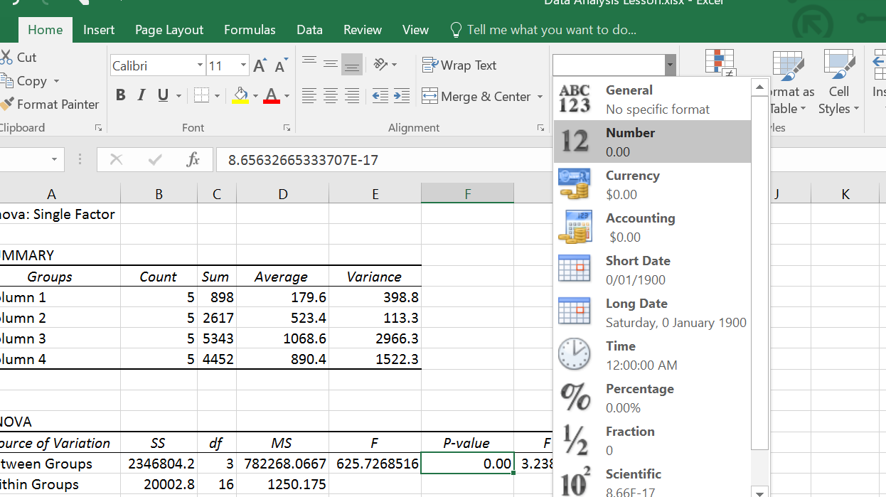
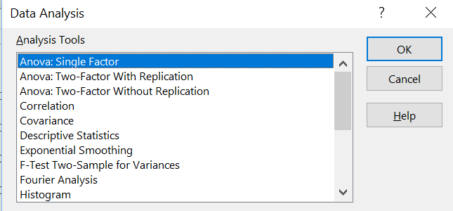
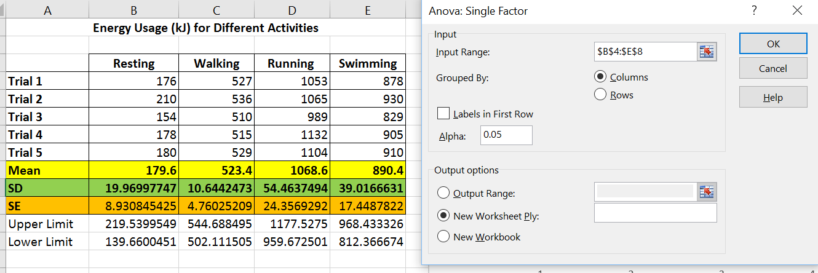
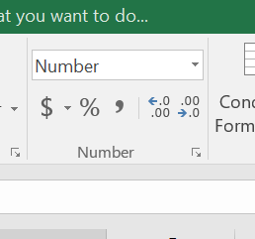
Anova (example)
P= LESS THAN 0.05 = SIGNIFICANT DIFFERENCE
Step 3: The only value you want is the P-value. Convert it to decimal by clicking on the value, select this button and click number.
Step 1: Click on Data Analysis and click on ANOVA: single factor.
Step 4: Click this button until you have a decimal value you can read.
Step 2: Click on the cells button, highlight all the data, click cells button again. Then click on ok.

Slide 20
Why is the P- value important
If your P-value is greater than 0.05, than the null hypothesis is correct and there is no significant difference between the means.
If your P-value is smaller than 0.05, than the null hypothesis should be rejected and there is significant difference between 1 or more of the variables.
To know what variables are different, more testing may need to be done in the form of t-tests.
Or look at the error lines in your graph. If the error lines on your graph are far apart from one another, it may indicate that those means are different to one another. But if the error bars overlap, that could indicate that the means are not significantly different and the differences in the means are due to chance. T- tests are more accurate though.

Slide 21
T-tests
T- tests are used to directly compare 2 sets of data to determine if there is a significant difference between the 2 sets. It is very similar to an ANOVA test, where we are trying to calculate a P value.
Like an ANOVA if the P value is less than 0.05 than the null hypothesis is disproved and there is a significant difference between the means. But the t-test allows us to directly compare eg body temp and 5 degrees, or body temp and 25 degrees.

Slide 22
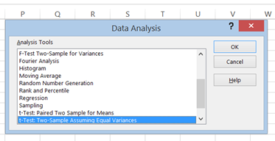
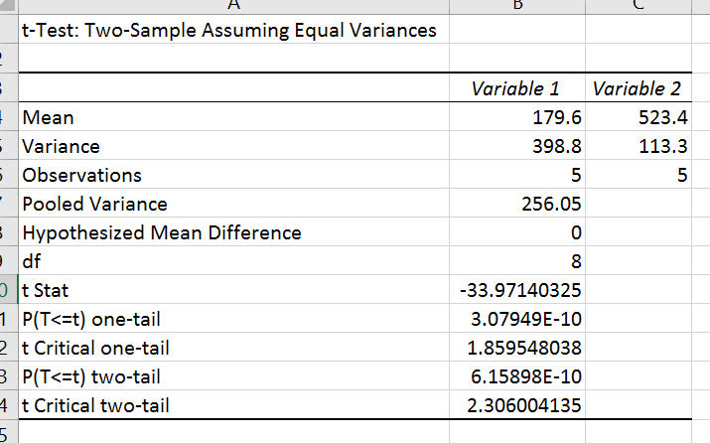
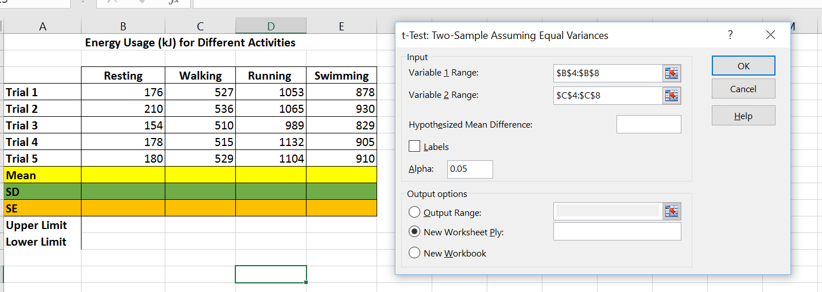
T-test example
P= LESS THAN 0.05 = SIGNIFICANT DIFFERENCE
Step 3 – Adjust the p value until you have a decimal value you can read.
Step 1 – Click on the data tab, click on data analysis, choose t-test two sample assuming equal variances and click ok.
Step 2 – Click the cells button and highlight data for first variable. Click the cells button and highlight data for the second variable. Click ok.

